Slide 1
The problem of Induction
Introduction to Philosophy
Philosophy 100
Class 7

Slide 2
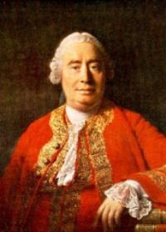

David Hume (1711 – 1776)
Scottish Philosopher, Mathematician, Economist , Freethinker, and Socialite
Empiricist of the Hardest Core
At age 23 wrote one of the most important works in all of philosophy. By age 32 he had written three books with that description.
Great

Slide 3
Hume’s Empiricism
Against Locke & Berkley
Against Descartes
Hume agreed with Locke & Berkley that all we can know is through the senses.
Hume wants to push empiricism to its logical limits, however.
Locke and Berkeley didn’t push their views hard enough or far enough.
Obviously if empiricism is correct, Descartes is wrong about knowledge.
We can push this issue further, according to Hume. With a better and clearer picture of empiricism, we cannot even conclude that we exist. All we are is a series of scattered impressions.

Slide 4
Empiricism does not entail that we have knowledge. It entails that knowledge can only be gained, if at all, by experience. Empiricists may assert that the rationalists are correct to claim that experience cannot give us knowledge. The conclusion they draw from this rationalist lesson is that we do not know at all.

Slide 5
Impressions and Ideas
Impressions are those things we immediately experience. They are visceral in a way that mere ideas, thoughts, or memories are.
Can include sense experiences, or emotions, or desires, etc.
Ideas are merely produced when we reflect on our impressions, but they are not nearly as strong.
All ideas are copies of our impressions.

Slide 6
Ideas are copies of impressions
Ideas
(Inward Impressions)
Perception
(Outward Impressions)
Complex thoughts are revisable into the simple ideas that they were copied from.
For example: “God is perfect, intelligent, and wise.”
Reflection on “God” will conjure in us the simple ideas, based on prior impressions, of human goodness, intelligence, and wisdom.
Suppose someone is blind. She could have no ideas of colour.
If sight were restored, she could have the simple impression of specific colours, from which she could then form the simple idea.
Complex impressions are of the totality of what one is perceiving right now.

Slide 7
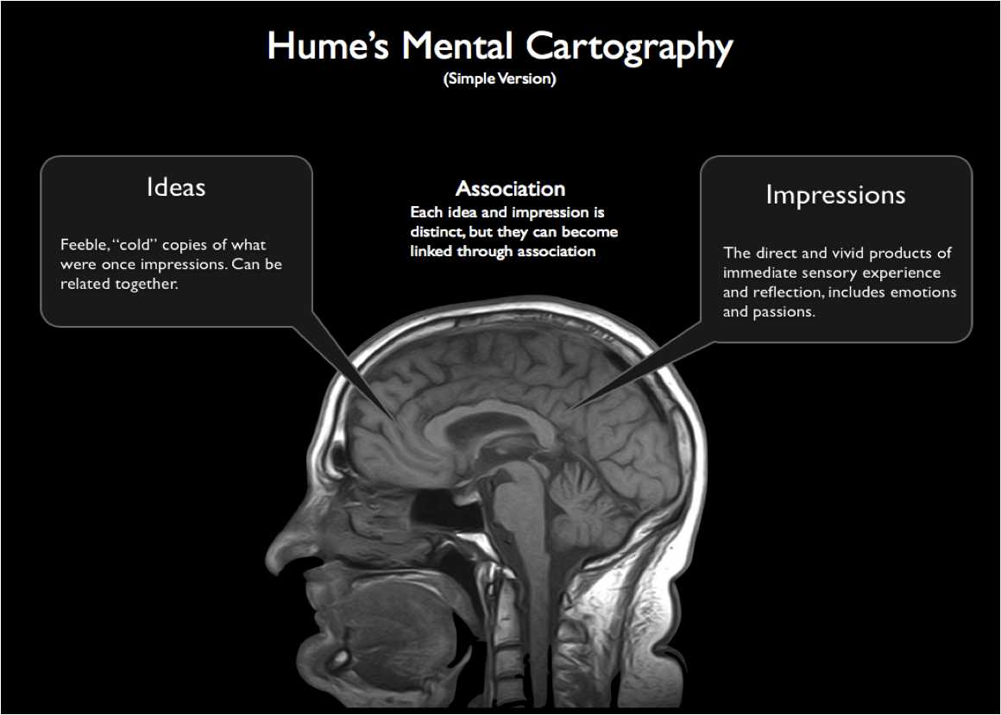
The First Upshot
No matter how impressive the mind’s capabilities might seem, it is entirely limited to impressions for it’s content.
All outward impressions require immediate sensation.
All inward impressions are based on current reflections.

Slide 8
Two Types of Understanding, or Hume’s Fork
Relation of Ideas
Matters of Fact
Mathematical and logical truths.
Tautologies or analytic statements:
All golden trumpets are golden.
All bachelors are unmarried.
We can be certain of these types of claims.
BUT….
Deductive a priori reasoning doesn’t tell us anything about the world and has no empirical content.
The stuff that happens in the world.
Empirical statements:
All trumpets are golden.
All bachelors are unfulfilled.
The contrary of every matter of fact is possible.
What reason do we have to think that matters of fact exist beyond our present experiences of them?

Slide 9
Causation & Matters of Fact
All reasoning to the belief in matters of fact is contingent on cause and effect.
Cause and effect is different from other types of relations, however.
Cause and effect are learned exclusively via sense experience—there is nothing a priori about cause and effect.
All events are distinct; the only way we garner our understanding of objects and their effects is through experience

Slide 10
The Relation of Cause and Effect
All we experience concerning matters of fact are individual events.
We do not see a causal connection between events; that is simply the work of our mind and our habits.
So there is a difference between what we associate in memory and what we can justifiably predict about the future

Slide 11
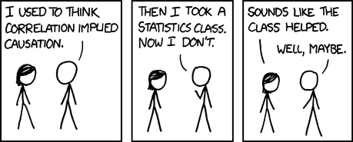
The Problem of Induction
If we ask, “Why think the past will resemble the future?” we cannot appeal to inferences based on our memories about the past.
Why: Because such inferences beg the question by assuming that the future will resemble the past, which is exactly what’s at issue!

Slide 12
Deduction versus Induction
Deduction
Induction
The Raptors and the Bucks are playing in the conference finals.
The conference finals cannot end in a tie.
Therefore, either the Raptors or the Bucks will win the conference finals.
The Raptors and the Bucks are playing in the conference finals.
In their histories, the Raptors win 50% of their playoff games, whereas the Bucks only win 33% of theirs.
Therefore, the Raptors will win the conference finals.

Slide 13
Inductive Arguments
You believe that this building is not going to collapse soon; if you didn’t believe this you certainly would not sit calmly in your seat listening to a boring lecture
Why do you believe that this building is not going to collapse?
You are probably relying on an inductive argument:
In the past, University buildings have not collapsed unexpectedly.
In the future, University buildings will not collapse unexpectedly.

Slide 14
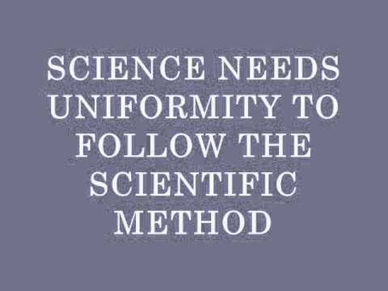
The Principle of Uniformity
In science and in everyday life we seem to rely on the conclusions of inductive arguments all the time
Hume argues that whenever we use an inductive argument we are tacitly relying on something referred to as the principle of the uniformity of nature:
Objects observed in the future will typically conform to patterns observed in the past

Slide 15
why should we accept the Principle of the Uniformity of Nature?
The Principle of the Uniformity of Nature does not appear to be analytic; the meaning of the words does not make the principle true.
Perhaps the Principle of the Uniformity of Nature can be justified using an inductive argument:
In the past, objects observed later have typically conformed to patterns observed earlier
Therefore, (by induction) objects observed in the future will typically conform to patters observed in the past
But, Hume argues, inductive arguments assume the Principle of the Uniformity of Nature
So to get from the Premise to the Conclusion, we have to assume that the Conclusion is true!
The inductive justification of induction is circular! It assumes what it is trying to prove.

Slide 16
Hume’s conclusion is VERY radical
He’s not just claiming that inductive reasoning sometimes leads to a false conclusion
Nor is he claiming that our beliefs based on induction should be held with caution
What he is claiming is that inductive arguments do not provide ANY justification for their conclusion
He is claiming that justification by induction is no better than justification by 8 Ball!
If Hume is right, then we have NO JUSTIFICATION AT ALL for believing
that the sun will rise tomorrow
that copper will continue to conduct electricity
that this building will not collapse in the next 10 minutes
that the next carrot you eat will not poison you
We have no justification at all for ANY of our beliefs about the future!

Slide 17
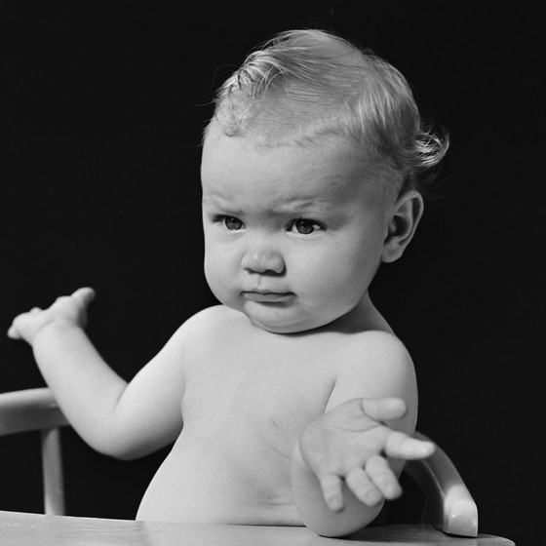
Second Upshot:
Any uniformity we find in nature is simply on the basis of custom or habit of the mind. We read cause and effect into nature based on earlier experiences, but have no reason to think that the future must resemble the past.
Since all ideas and complex connections of the mind require impressions, and all impressions are of distinct events, we cannot know anything beyond what is being immediately experienced!

Slide 18
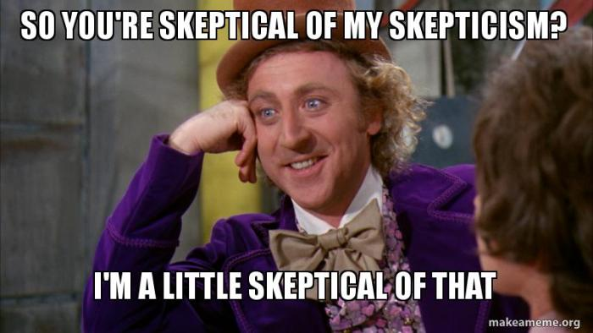
Attempted Response to the POI

Slide 19
Karl Popper
Popper agreed with Hume that induction is not a justified form of inference
Unlike Hume, he did not think that this posed a major problem for science because (he argued) good science does not use induction
Instead, he claimed, the method of good science is a trial and error method of “conjectures and refutations”
A scientist proposes a hypothesis or theory (a “conjecture”) and then the scientist and the rest of the scientific community attempt to falsify (or “refute”) the theory
Popper rejected the idea that the theory we accept at a given time is the one that is best supported by inductive evidence
He denied that scientific theories are justified by induction
Rather, the theory accepted at a given time is the theory that has not yet been refuted
There are some theories which are not falsifiable -- no evidence or observation would show that they are false
Popper insisted that those theories are not genuine scientific theories at all
One of his favorite examples was Freudian psychoanalysis which, he claimed, makes no predictions and thus cannot be falsified
E.g. Freud claimed that all boys have an unconscious desire to kill their father & have sex with their mother
But this claim is impossible to falsify

Slide 20
A problem for Popper’s account of science
At any given time there are typically a large number of conjectures about a given topic that have not been refuted.
Consider our first example of an inductive inference
“All pieces of copper conduct electricity”
has not been refuted.
Here are some other unrefuted conjectures:
All pieces of copper will conduct electricity until tonight at midnight, at which time they will stop conducting electricity
All pieces of copper will conduct electricity until tomorrow night at midnight, at which time they will stop conducting electricity
All pieces of copper will conduct electricity until midnight on Aug. 15, 2019, at which time they will stop conducting electricity.

Slide 21
But that’s not the only relevant conjecture that has not been refuted
Though none of these conjectures has been refuted, we do not take any of them seriously
If we took all the unrefuted conjectures seriously, it would be impossible to use science to make practical decisions
Rather, we assume that only the first
All pieces of copper conduct electricity
is (probably) true and all the rest of them are (probably / almost certainly) false
Popper’s “conjectures and refutations” methodology does not explain how scientists can (usually) come up with a single accepted hypothesis which they act on and assume to be probably true
So it looks like Popper has not given us an account of the methodology of science that comports with actual scientific practice.

Slide 22


